Slide 1
EXPERIMENTAL & MEASUREMENTS
LABORATORY
MM-215
Prof. N K Khosla, Prof. Titas Dasgupta
Prof. Aswani Yella

Slide 2
Marking procedure
1 quiz for 30 marks = 30
Each experiment 10 marks = 70
1. Experiment Videos will be uploaded on moodle
2. Bring earphones if you want to watch video in lab
3. 10 TAs and 2 lab assistants

Slide 3
Study of the PC Oscilloscope &
low pass RC filter

Slide 4
Components for the first experiment
Bread board
Resistors
Capacitors
RC filters
Oscilloscope

Slide 5
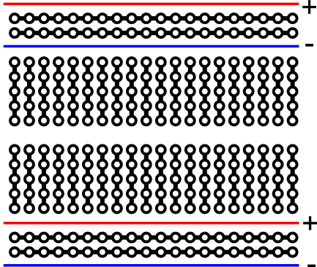
What is a breadboard?
What are they good for?
Creatings, organizing, and prototyping a circuit.
Literally started out as a bread board with nails.
￼
Notes:
Find a interactive example. Also, show an old fashioned breadboard example.

Slide 6
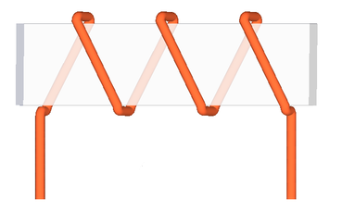
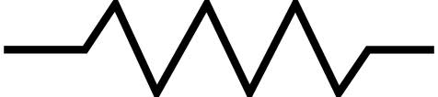
What are resistors?
Resistors provide a specific amount of resistance to a path in a circuit or wire. Ohm's law is used to calculate the properties related to resistance.
Ohm's Law: I = V/R
I = Current measured in Amps
V = Voltage measured in Volts
R = Resistance measured in Ohms
Resistors are color coded.

Slide 7
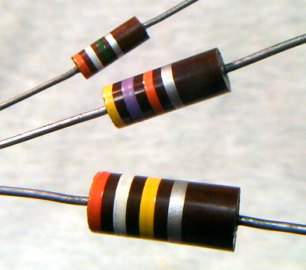
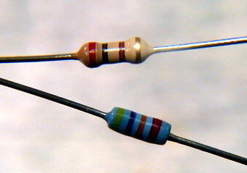
Resistor ratings
Physical size of resistors determines power handling ability
Commonly available as 1/8, 1/4, 1/2, 1,
and 2 watt components
Much higher powers available , usually as wirewound or ceramic encapsulated parts
Notes:
Good practice is to select a resistor whose power rating is at least two or three times the expected power dissipation. For most low power, low voltage circuits, ¼ watt resistors are appropriate. The three 10% tolerance carbon composition reistors shown are (top to bottom) ½ watt, 1 watt, and 2 watt. Their values are 3.9M, 47K, and 390K. The two smaller resistors are ¼ watt, the top is carbon film, 200Ω 5%, and the bottom is metal film, 47K 2%.

Slide 8
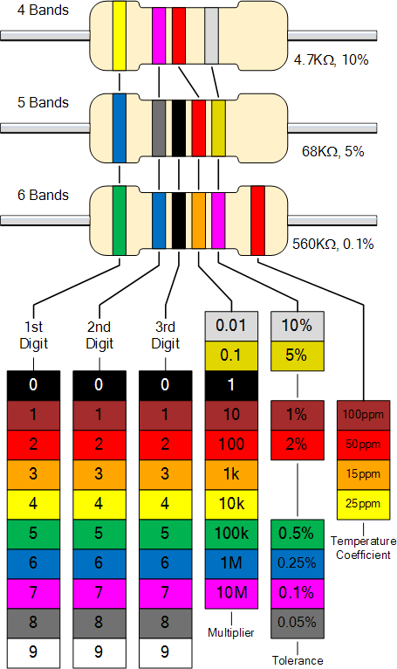
Resistors Colour Code
1st
2nd
3rd
multiplier
Tolerance

Slide 9
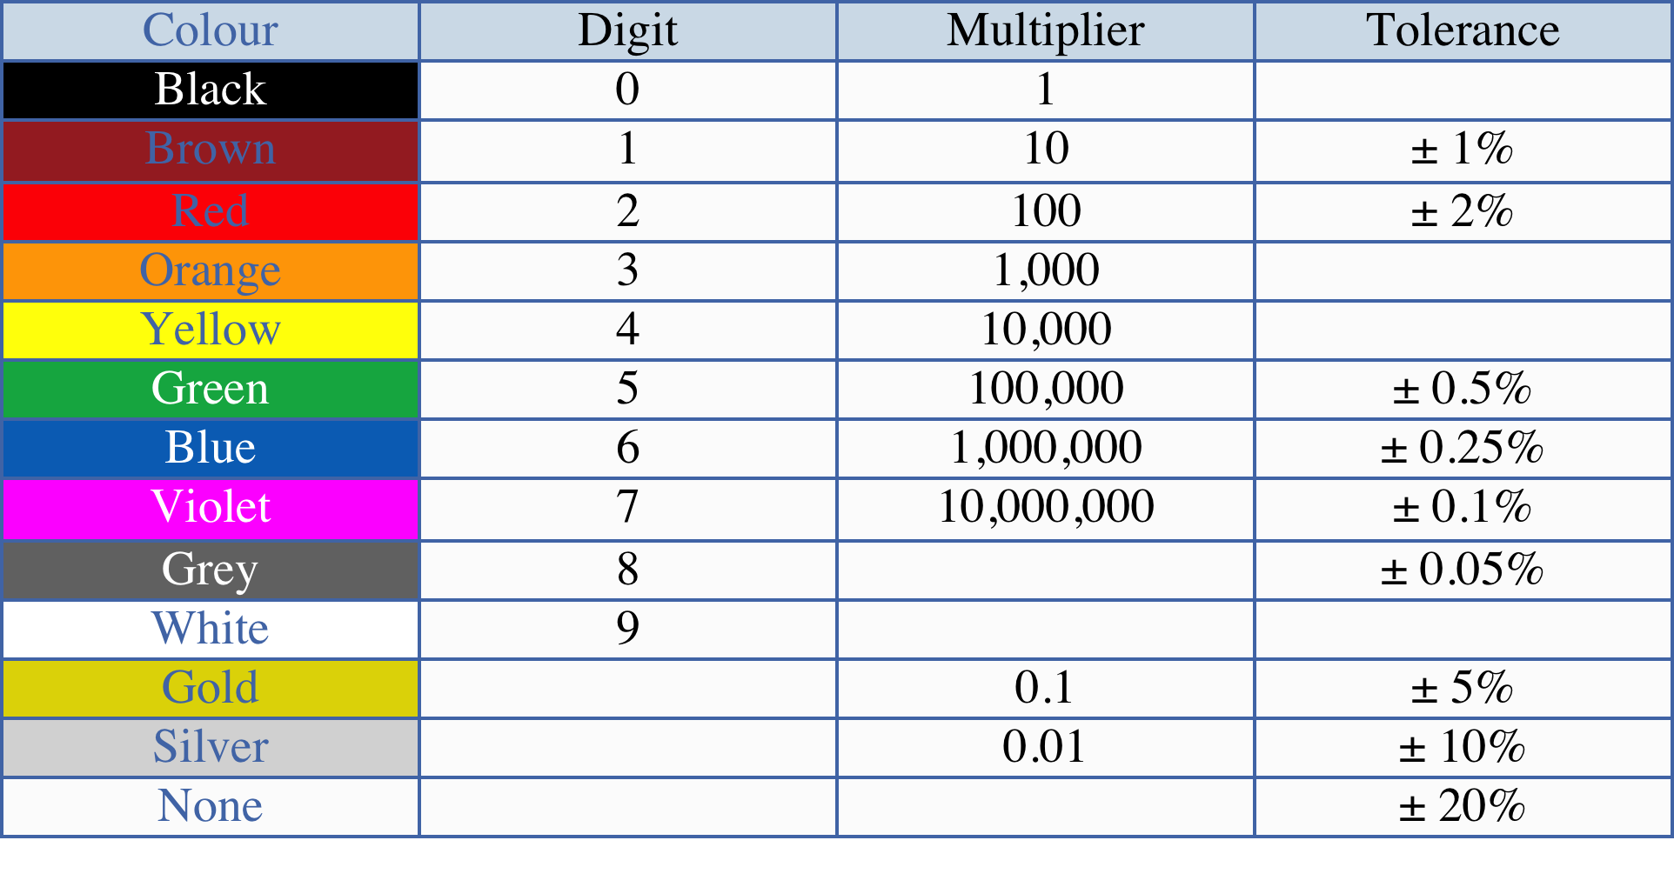
Resistors Colour Code

Slide 10
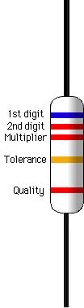
Resistors Colour Code
1st Digit, 2nd Digit, 3rd Digit, Multiplier
= Colour, Colour, colour x 10^{colour}
Blue, orange, red, gold
Black, Brown, Red, Orange, Yellow, Green, Blue, Violet, Grey, White
B.B.ROY of Great Britain had a Very Good Wife wearing Gold & Silver Necklace
Notes:
There have been various other ditties used in the past to remember the color code. Most are unsuitable for polite company.
When the tolerance band is not present, 20% tolerance is assumed.
Some precision resistors will have three “significant digit” bands before the multiplier band.

Slide 11
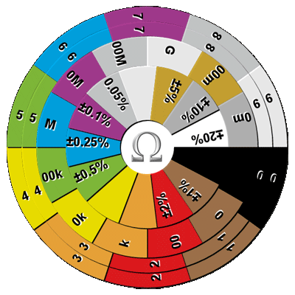
Resistor Color Code
Resistor Color Code Wheel Calculator

Slide 12
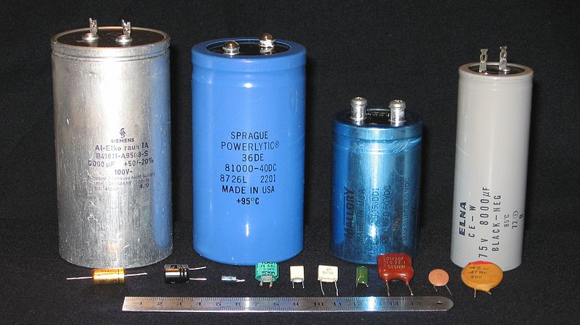
Capacitors
Capacitors are circuit components that store electrical charge.
Capacitors have two conductors separated by an insulator called the dielectric.
When there is an electric potential across the capacitor (a difference in the voltage), electrons cannot flow across the gap; instead, one end becomes positively charged and the other becomes negatively charged, and an electric field forms between the conductors.

Slide 13
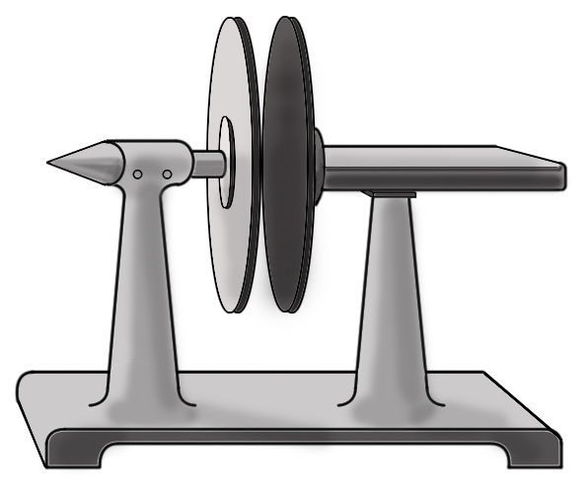
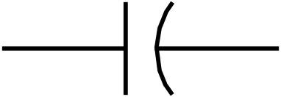
Capacitors in Circuits
When a circuit first comes on, the charge in the capacitor begins to build. Electrons gathering on one end and vacating the other create a temporary current as they move. As they do so, the voltage across the capacitor increases and the current decreases.
After the circuit has been on for a long time (steady-state), there is a voltage across the capacitor and no current through it. At steady-state conditions, a capacitor acts like a break in the circuit.
The symbol for a capacitor is like two plates near one another; this resembles the construction of basic capacitors.
[Picture of plate capacitor]

Slide 14
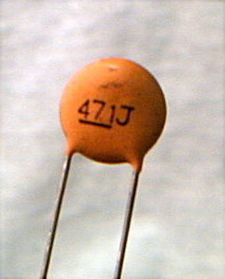
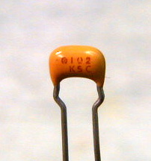
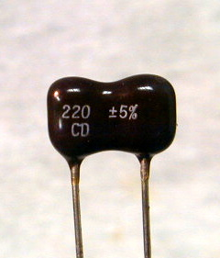
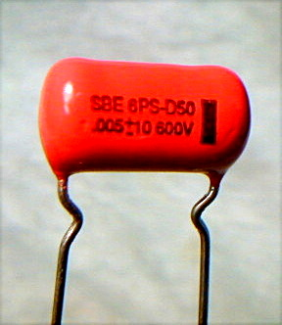
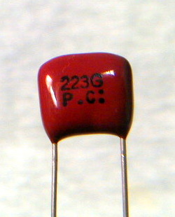
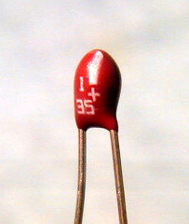
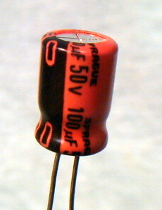
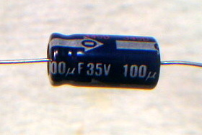
Capacitor types
Ceramic disk
Monolithic ceramic
Dipped siver-mica
Mylar
Mylar
Ceramic disk
Monolithic ceramic
Dipped silvered-mica
Mylar or polyester
Aluminum electrolytic (+/-)
Tantalum (+/-)
Solid tantalum, polarized
Radial aluminum electrolytic
Axial aluminum electrolytic
Notes:
Ceramic disk – 471J means 47 x 10¹ pf, or 471 pF, the J stands for 5% tolerance
Monolithic ceramic – 102 means 10 x 10² pf or 1000 pf, or 0.001 μF
Dipper mico – 220 means 220 pF
Mylar (left) - .005 means 0.005 μF
Mylar (right) – 223 means 22 x 10³ pF or 22000 pF or 0.022 μF
Solid tantalum – 1 35 means 1 μF at 35 WVDC
Radial aluminum – as marked 100 μF at 50 WVDC
Axial aluminum – as marked 100 μF at 35 WVDC

Slide 15
Capacitors
Values specified in microfarads (μF) or picofarads (pF)
Marked with actual value or a numeric code
Some varieties are +/- polarized
Notes:
The nanofarad (nF) is commonly used in Europe, but that nomenclature is rare in USA and Canada.
Polarized capacitors are often referred to as electrolytics because the plate and dieletric structures are formed by a chemical reaction involving an electrolyte.

Slide 16
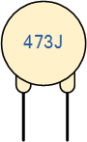
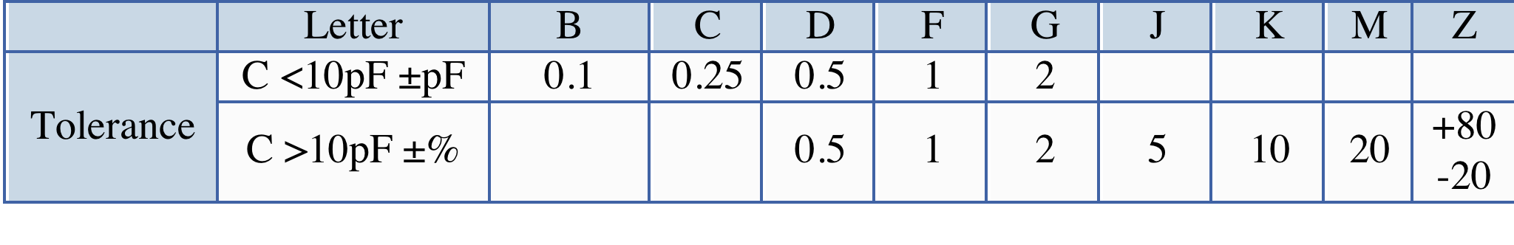
Capacitor value code
1st digit, 2nd digit, multiplier in picofarads
Physical size of capacitors is related to voltage handling ability
Temperature coefficient may also be important – can be + or – or nearly zero
Temperature coefficient depends upon dielectric material
Notes:
NP0 (read N P zero) capacitors are the most temperature stable commonly available types. But they are gernerally only made in values up to a few hundreds of picofarads. Temperature stability is only an important consideration if the capacitor is part of a timing or frequency-determining circuit.

Slide 17
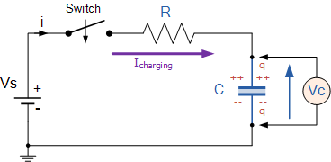
RC circuit
This combination is useful to study because capacitors can be used to store energy and a resistor placed along with the capacitor can control the rate at which energy is released from the capacitor.

Slide 18
RC circuit
All Electrical circuits suffer from some form of “time-delay” between its input and output
In a steady state, ideal capacitors draw no current. But if a circuit is assembled and switched on, one will observe that it take time for the capacitor to receive its full charge.
This delay is generally known as the time delay or Time Constant of the circuit
Since capacitors accumulate a charge Q, the resistors in series with them carry a current I = dQ/dt. The current in the series R should decrease to zero as C reaches its full charge.

Slide 19
RC circuit
we can use Kirchoff's Laws to write the voltage drop across the circuit
V_{o} - R.i(t) - V_{c}(t) = 0
voltage drop across a capacitor will be Q/C, we can rewrite this equation as
dQ/dt + Q/RC = V₀/R
Solving the differential equation we will get
Q(t) = Q_{o}(1-e^{-t/RC})
Since the voltage is related to the charge by V= Q/C, we can rewrite this as
V_{C} = V₀(1-e^{-t/RC})
i(t) = i₀e^{-t/RC}

Slide 20
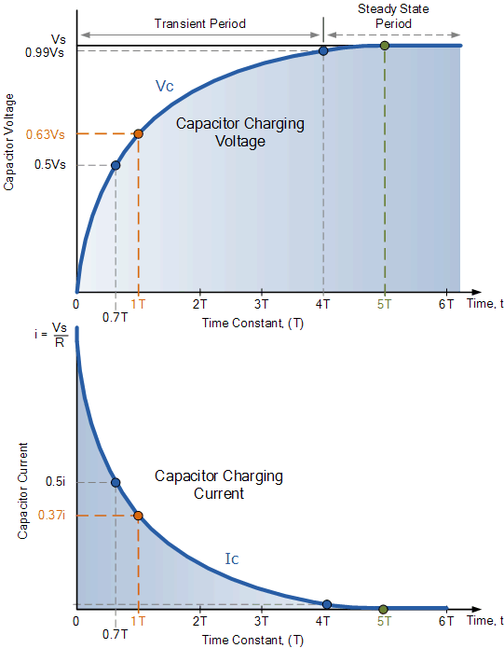
RC circuit

Slide 21
RC circuit

Slide 22
RC circuit
The graphs as a function of time signifies
a.) Initially, the current through an RC circuit in which the capacitor is initially uncharged is at a maximum. That is, the capacitor initially acts like it is a short (i.e., not even there). It isn't until charge begins to accumulate that charge flow begins to diminish.
b.) one time constant.
One time constant is defined as τ = RC
Putting one time constant into our current expression (i.e., letting t = RC) yields:
i = i_{o}e^{-RC/RC} = i_{o}(e⁻¹) = 0.37i_{o}.
time it takes the circuit's current to diminish to 37% of its initial value.
time required for the capacitor to charge to 63% of its maximum
Multiplying the value of the capacitance and resistance together, the number we end up with will:
Have the units of ------

Slide 23
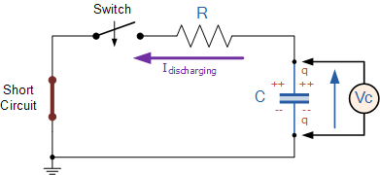
RC circuit
V_{C} = V₀e^{-t/RC}
i(t) = i₀(1-e^{-t/RC})

Slide 24
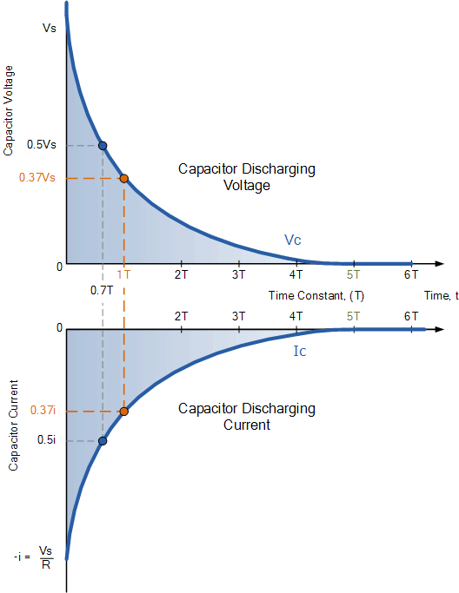
RC circuit

Slide 25
RC circuit
The charge/discharge characteristics of a capacitor in an RC circuit are symmetric.

Slide 26
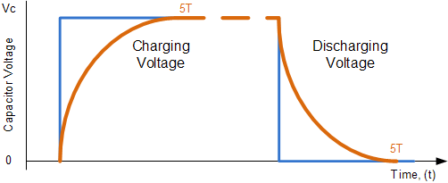
RC circuit
Pulsed or a square wave that changes constantly from a maxima to minima with a certain frequency

Slide 27
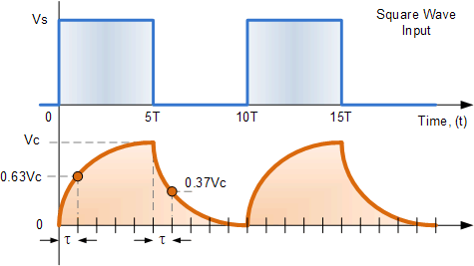
RC circuit

Slide 28
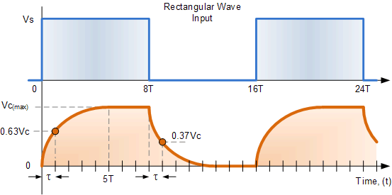
RC circuit

Slide 29
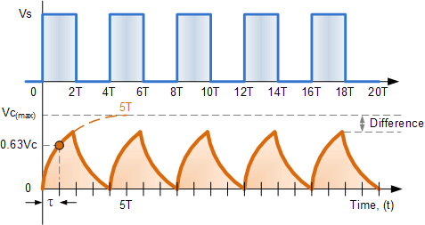
RC circuit

Slide 30
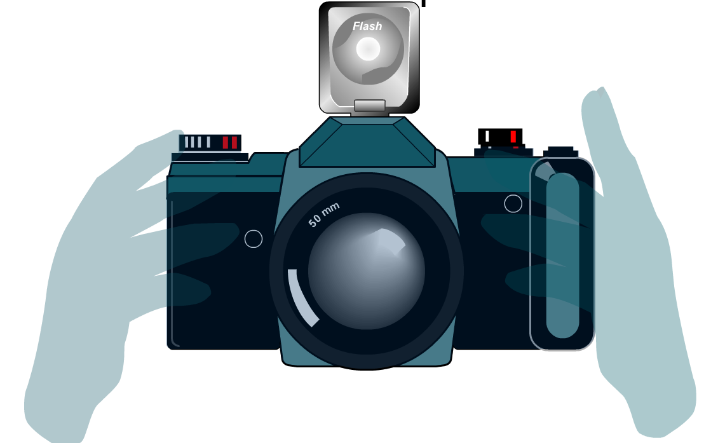
RC circuit applications
The internal working of a camera´s flash
is a good example of RC circuits
When the camera is switched on,
the battery slowly charges up the
capacitor to its full potential
via an RC Circuit
The flash rapidly draws current inorder to emit the bright light
Discharge of capacitor through flash and
current from the capacitor is responsible for the bright light

Slide 31
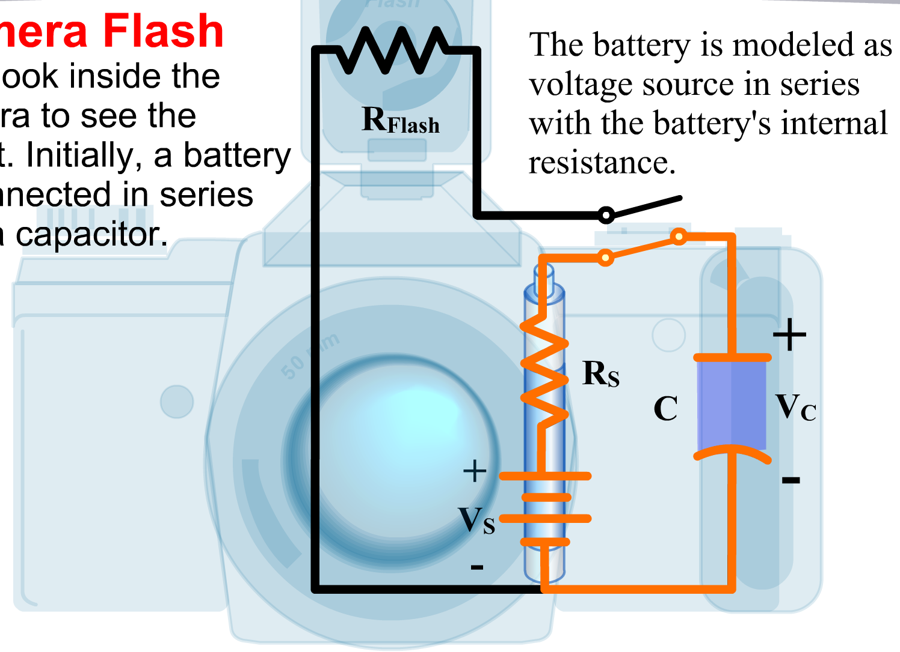
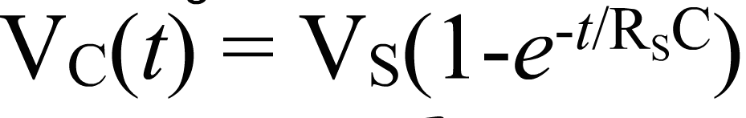
RC circuit applications
The capacitor is charged by the source voltage Vs
V_{C} = V_{S}
(fully charged)

Slide 32
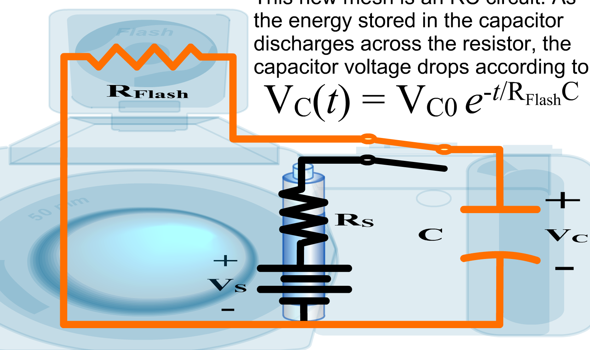
RC circuit applications
Disconnecting the capacitor from the voltage source and connecting to flash resistor
Capacitor discharges across the resistor

Slide 33
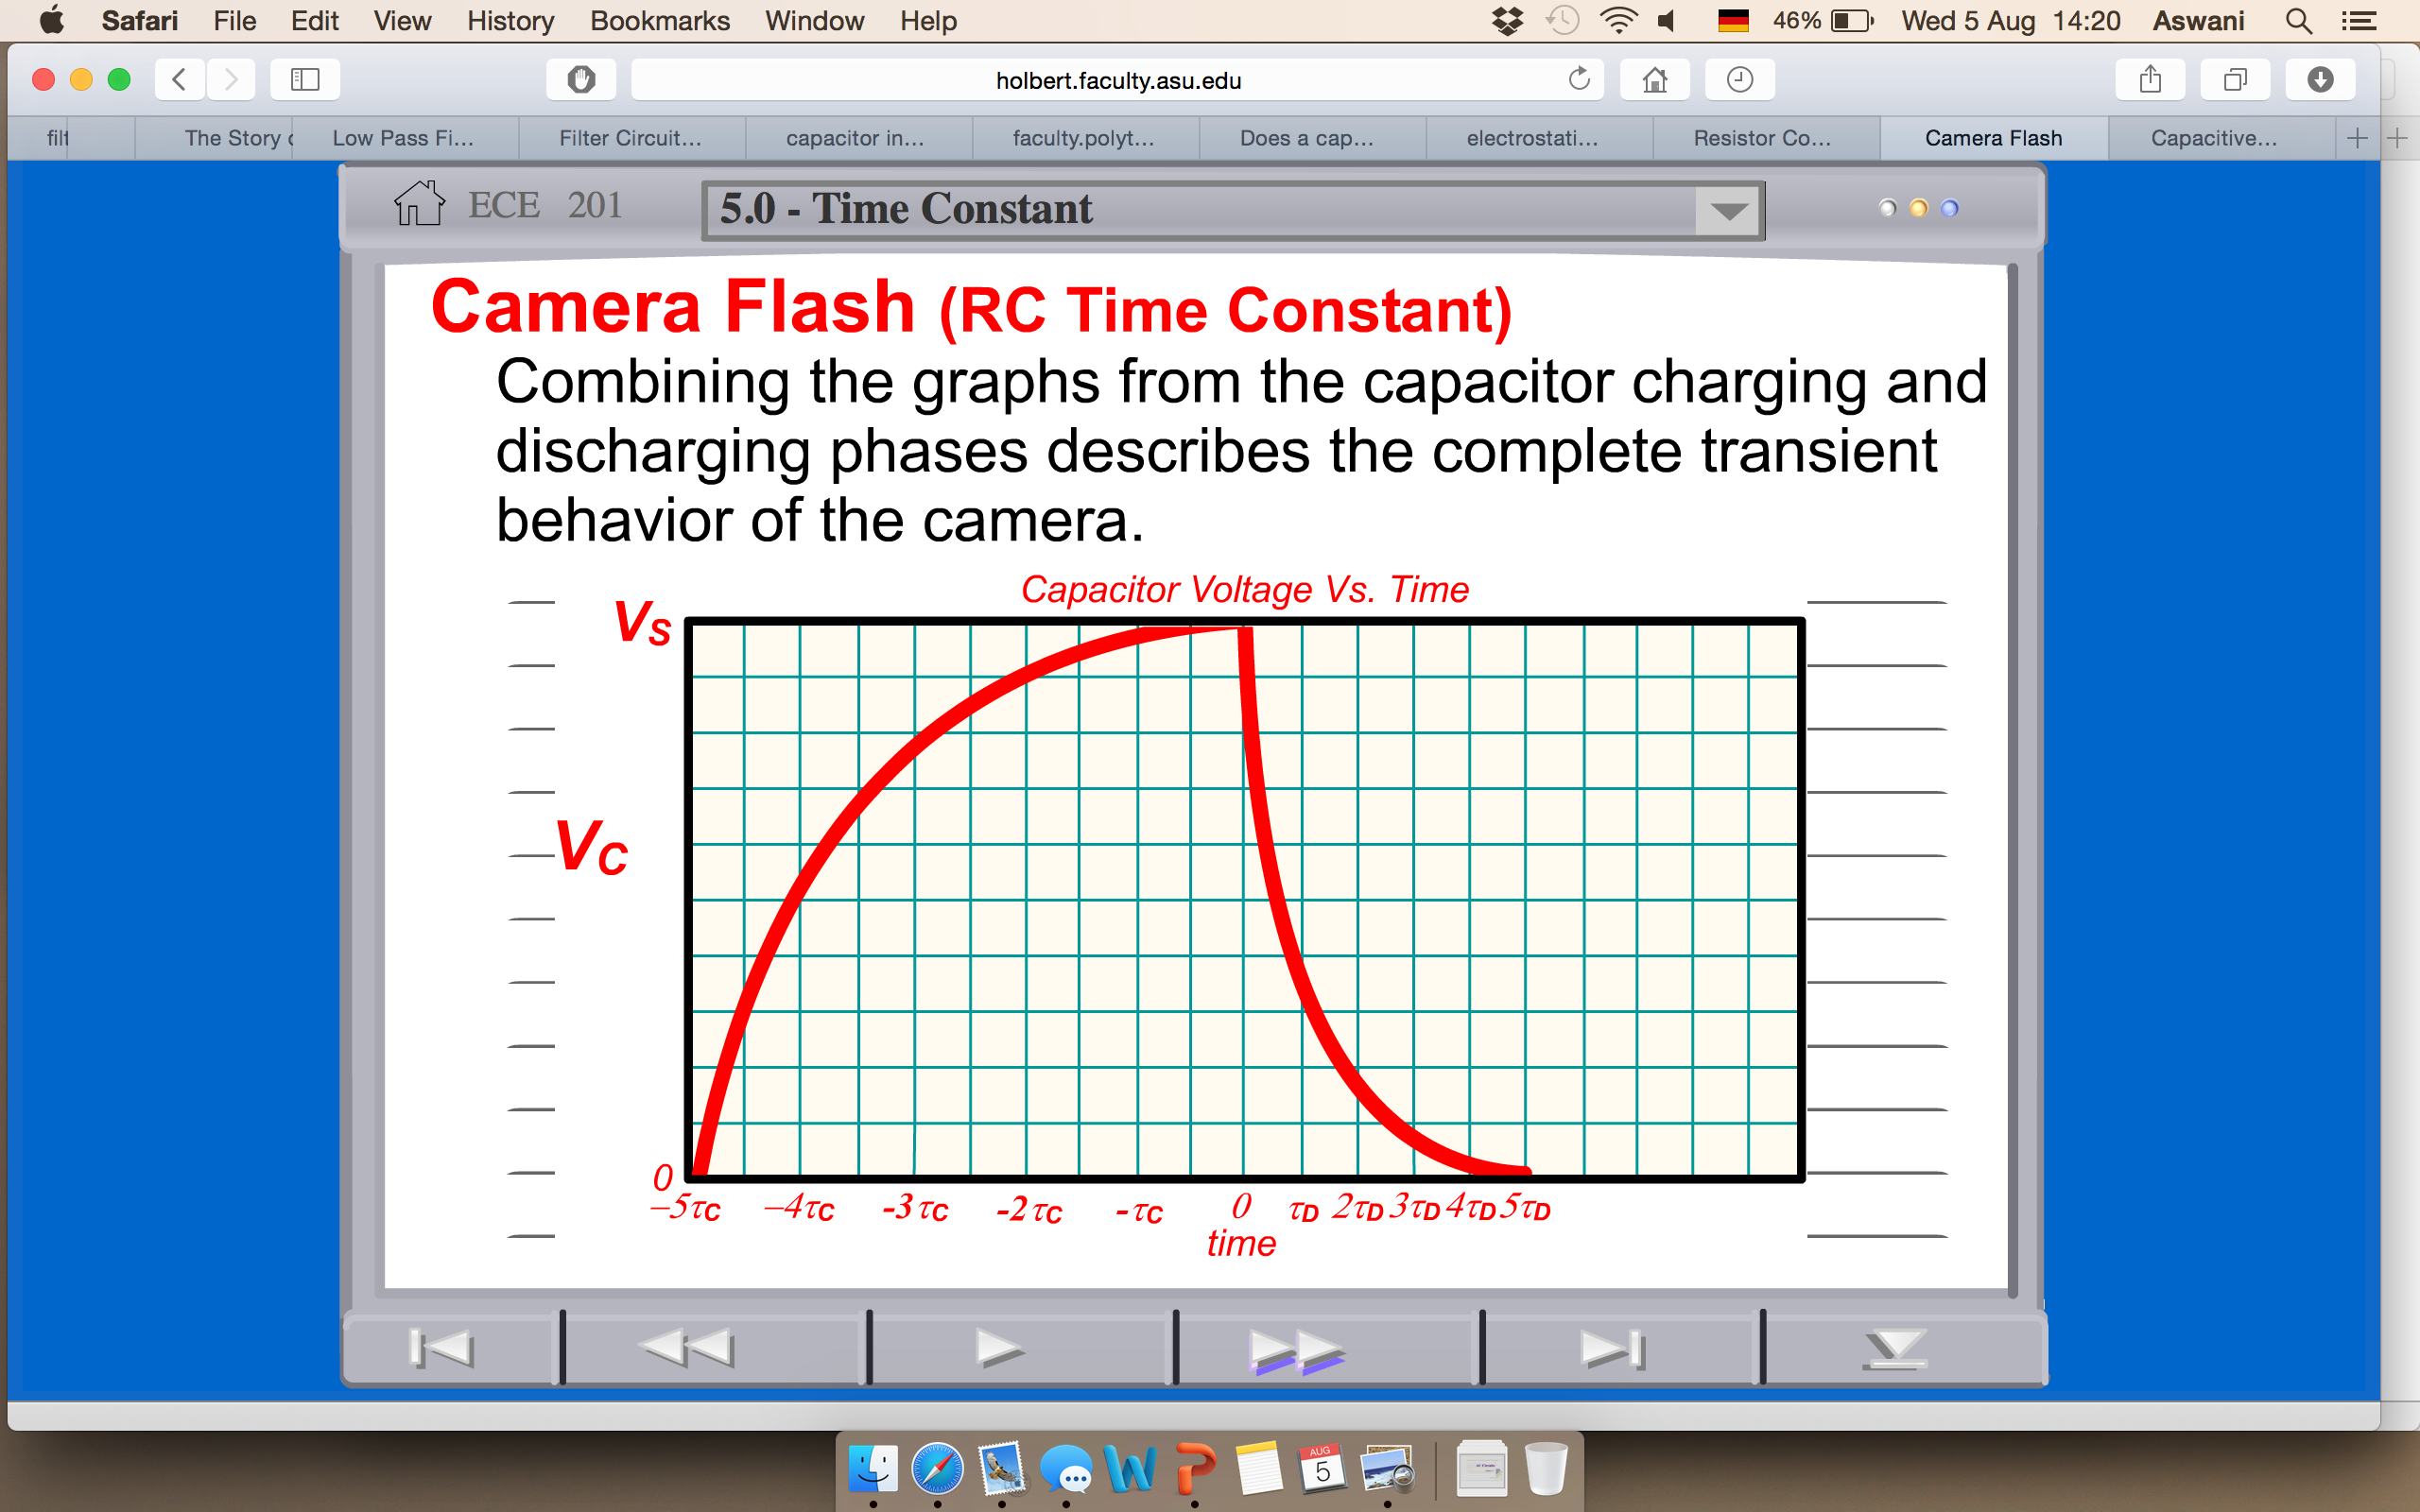
RC circuit applications

Slide 34
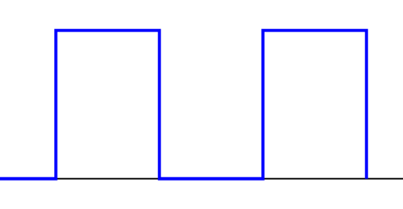
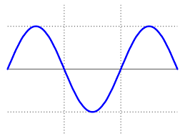
RC filters
Sine wave instead of a square wave
What will be output waveform in the case of sine wave?
How about the amplitude?

Slide 35
RC filters
An electrical filter is a circuit which filter-out unwanted signals and an ideal filter will separate and pass sinusoidal input signals based upon their frequency
Filters are so named according to the frequency range of signals that they allow to pass through them, while blocking the rest.
The Low Pass Filter - 0Hz to f_{c}
The High Pass Filter - f_{c} to infinity
3. The Band Pass Filter - 0Hz- f_{L} and f_{H}-infinity

Slide 36
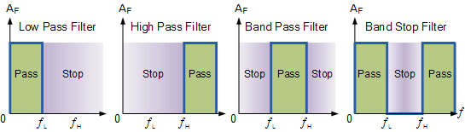
RC filters
Ideal filter response
By changing the positions of the Resistor, R or the Capacitor, C a simple first order low pass or high pass filters can be made with the frequency response of these two circuits dependant on the input frequency

Slide 37
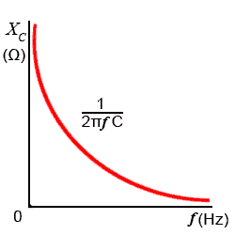
RC filters
Capacitor in an AC circuit will have
capacitive reactance X_{C}
X_{C} = 1/2πfC in ohm´s
V_{out} = V_{in} (X_{c}/(R² + X_{c}²)^{1/2})
Calculate frequency dependence of a 47kohm resistor in series with a 47nF capacitor
Connected across a 10V sinusoidal supply with two different frequencies 100Hz and 10KHz
Above the cut-off frequency everything else will be blocked
f_{c} = 1/2πRC
Notes:
At low frequencies the capacitive reactance, ( Xc ) of the capacitor will be very large compared to the resistive value of the resistor, R. This means that the voltage potential, Vc across the capacitor will be much larger than the voltage drop, Vr developed across the resistor. At high frequencies the reverse is true with Vc being small and Vr being large due to the change in the capacitive reactance value
The impedance of resistor R1 does not change with frequency. Resistors are of fixed values and are unaffected by frequency change. Then the voltage across resistor R1 and therefore the output voltage is determined by the capacitive reactance of the capacitor at a given frequency. This then results in a frequency-dependent RC voltage divider circuit

Slide 38
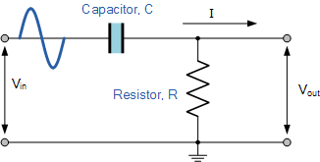
RC filters
Above the cut-off frequency point, the reactance of the capacitor has reduced sufficiently as to now act more like a short circuit allowing all of the input signal to pass directly to the output as shown below in the filters response curve
Notes:
The impedance of resistor R1 does not change with frequency. Resistors are of fixed values and are unaffected by frequency change. Then the voltage across resistor R1 and therefore the output voltage is determined by the capacitive reactance of the capacitor at a given frequency. This then results in a frequency-dependent RC voltage divider circuit

Slide 39
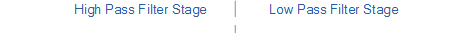
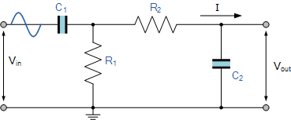
RC filters

Slide 40
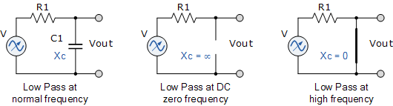
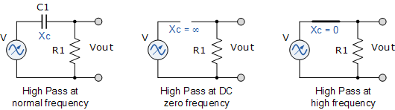
Summary
Low pass RC filter
RC circuit in DC voltage
High pass RC filter

Slide 41
THANK YOU

Slide 42
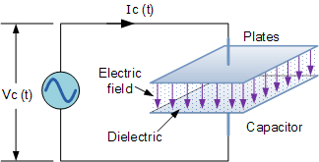
Capacitors in AC circuit
In anAC Circuit in which the applied voltage signal is continually changing from a positive to a negative polarity at a rate determined by the frequency of the supply, as in the case of a sine wave voltage, for example, the capacitor is either being charged or discharged on a continuous basis at a rate determined by the supply frequency.
As the capacitor charges or discharges, a current flows through it which is restricted by the internal resistance of the capacitor. This internal resistance is commonly known as Capacitive Reactance and is given the symbol XC in Ohms.

Slide 43
Capacitors in AC circuit
Unlike resistance which has a fixed value, for example, 100Ωs, 1kΩ, 10kΩ etc, (this is because resistance obeys Ohms Law), Capacitive Reactance varies with the applied frequency so any variation in supply frequency will have a big effect on the capacitors, “capacitive reactance” value.
As the frequency applied to the capacitor increases, its effect is to decrease its reactance (measured in ohms). Likewise as the frequency across the capacitor decreases its reactance value increases. This variation is called the capacitors complex impedance.
Complex impedance exists because the electrons in the form of an electrical charge on the capacitor plates, pass from one plate to the other more rapidly with respect to the varying frequency.
As the frequency increases, the capacitor passes more charge across the plates in a given time resulting in a greater current flow through the capacitor appearing as if the internal resistance of the capacitor has decreased. Therefore, a capacitor connected to a circuit that changes over a given range of frequencies can be said to be “Frequency Dependant”.

Slide 44
Capacitive Reactance

Slide 45
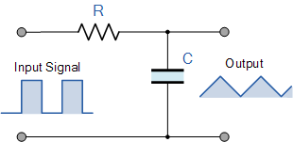
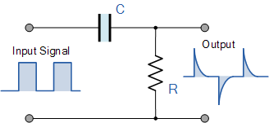
RC circuits

Slide 46
RC filters
The impedance of resistor R1 does not change with frequency. Resistors are of fixed values and are unaffected by frequency change. Then the voltage across resistor R1 and therefore the output voltage is determined by the capacitive reactance of the capacitor at a given frequency. This then results in a frequency-dependent RC voltage divider circuit. With this idea in mind, passive Low Pass Filters and High Pass Filters can be constructed by replacing one of the voltage divider resistors with a suitable capacitor as shown.

